Slide 1
Network Layer
Chapter 5
  Design Issues
  Routing Algorithms
  Congestion Control
  Quality of Service
  Internetworking
  Network Layer of the Internet
Revised: August 2011
CN5E by Tanenbaum & Wetherall, © Pearson Education-Prentice Hall and D. Wetherall, 2011
Notes:
Gray units can be optionally omitted without causing later gaps

Slide 2
Flooding
A simple method to send a packet to all network nodes
Each node floods a new packet received on an incoming link by sending it out all of the other links
Nodes need to keep track of flooded packets to stop the flood; even using a hop limit can blow up exponentially
CN5E by Tanenbaum & Wetherall, © Pearson Education-Prentice Hall and D. Wetherall, 2011
Notes:
Note that flooding doesn’t actually find any routes that can be reused.

Slide 3
Flooding
Flooding obviously generates vast numbers of duplicate packets (infinite number) unless some measures are taken to damp the process.
    A hop counter contained in the header of each packet , decremented at each hop, and discarded when the counter reaches zero. Ideally, the hop counter should be initialized to the length of the path from source to destination. If the sender does not know how long the path is, it can initialize the counter to the worst case(diameter of the subnet)
    Add sequence number in each packet a router receives from its hosts, Each router then needs a list per source router telling which sequence numbers originating at that source have already been seen. If an incoming packet is on the list, it is not flooded.
CN5E by Tanenbaum & Wetherall, © Pearson Education-Prentice Hall and D. Wetherall, 2011

Slide 4
Flooding
Flooding is not practical in most applications, but it does have some uses.
    In military applications, where large numbers of routers may be blown to bits at any instant, the tremendous robustness of flooding is highly desirable.
    In distributed database applications, it is sometimes necessary to update all the databases concurrently, in which case flooding can be useful.
    In wireless networks, all messages transmitted by a station can be received by all other stations within its radio range, which is, in fact, flooding, and some algorithms utilize this property. A fourth possible use of flooding is as a metric against which other routing.
CN5E by Tanenbaum & Wetherall, © Pearson Education-Prentice Hall and D. Wetherall, 2011

Slide 5
Distance Vector Routing
Modern computer networks generally use dynamic routing algorithms rather than the static, because static algorithms do not take the current network load into account.
Two dynamic algorithms in particular:
Distance vector routing
Link state routing,
are the most popular
CN5E by Tanenbaum & Wetherall, © Pearson Education-Prentice Hall and D. Wetherall, 2011

Slide 6
Distance Vector Routing
Distance vector is a distributed routing algorithm, operate by having each router maintain a table (a vector) giving the best known distance to each destination and which line to use to get there.
These tables are updated by exchanging information with the neighbors.
CN5E by Tanenbaum & Wetherall, © Pearson Education-Prentice Hall and D. Wetherall, 2011
Notes:
How long will it take to converge? The diameter of the network.

Slide 7
Distance Vector Routing
Each router maintains a routing table indexed by, and containing one entry for, each router in the subnet.
    This entry contains two parts: the preferred outgoing line to use for that destination and an estimate of the time or distance to that destination.
The metric used might be number of hops, time delay in milliseconds, total number of packets queued along the path, or something similar.
CN5E by Tanenbaum & Wetherall, © Pearson Education-Prentice Hall and D. Wetherall, 2011

Slide 8
Distance Vector Routing
The router is assumed to know the ''distance'' to each of its neighbors.
    If the metric is hops, the distance is just one hop.
    If the metric is queue length, the router simply examines each queue.
    If the metric is delay, the router can measure it directly with special ECHO packets that the receiver just timestamps and sends back as fast as it can.
CN5E by Tanenbaum & Wetherall, © Pearson Education-Prentice Hall and D. Wetherall, 2011

Slide 9
Distance Vector Routing (1)
Algorithm:
  Each node knows distance of links to its neighbors
  Each node advertises vector of lowest known distances to all neighbors
  Each node uses received vectors to update its own
  Repeat periodically
    Triggered update
    Periodic update
CN5E by Tanenbaum & Wetherall, © Pearson Education-Prentice Hall and D. Wetherall, 2011
Notes:
How long will it take to converge? The diameter of the network.

Slide 10
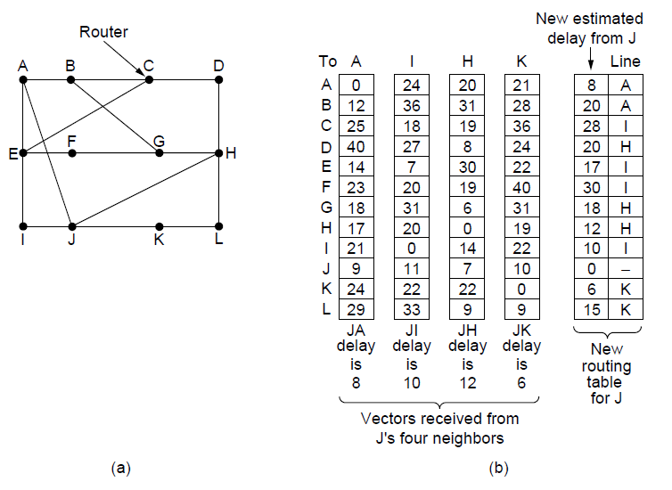
Distance Vector Routing (2)
Network
New vector for J
Vectors received at J from
Neighbors A, I, H and K
CN5E by Tanenbaum & Wetherall, © Pearson Education-Prentice Hall and D. Wetherall, 2011

Slide 11
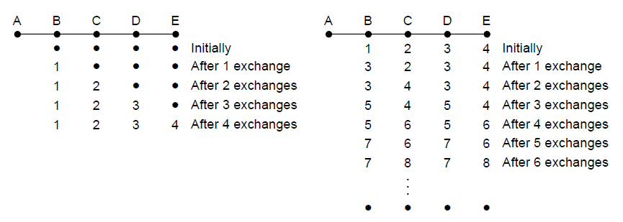
The Count-to-Infinity Problem
Failures can cause DV to “count to infinity” while seeking a path to an unreachable node
X
Good news of a path to A spreads quickly
Bad news of no path to A is learned slowly
CN5E by Tanenbaum & Wetherall, © Pearson Education-Prentice Hall and D. Wetherall, 2011

Slide 12
Link State Routing (1)
Link state is an alternative to distance vector
  More computation but simpler dynamics
  Widely used in the Internet (OSPF,ISIS)
CN5E by Tanenbaum & Wetherall, © Pearson Education-Prentice Hall and D. Wetherall, 2011
Notes:
Link state routing is the second family of routing protocols. While distance vector routers use a distributed algorithm to compute their routing tables, link-state routers exchange messages to allow each router to learn the entire network topology. Based on this learned topology, each router is then able to compute its routing table by using a shortest path computation.

Slide 13
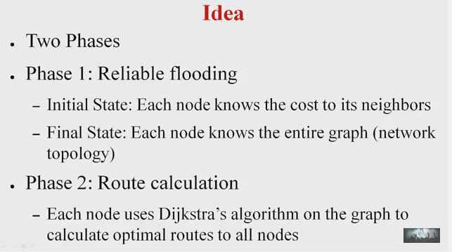
Link State Routing
CN5E by Tanenbaum & Wetherall, © Pearson Education-Prentice Hall and D. Wetherall, 2011

Slide 14
Link State Routing (1)
Algorithm:
  Each node floods information about its neighbors in LSPs (Link State Packets); all nodes learn the full network graph
  Each node runs Dijkstra’s algorithm to compute the path to take for each destination
CN5E by Tanenbaum & Wetherall, © Pearson Education-Prentice Hall and D. Wetherall, 2011

Slide 15
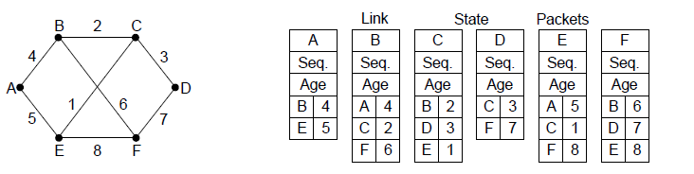
Link State Routing (2) – LSPs
LSP (Link State Packet) for a node lists neighbors and weights of links to reach them
Network
LSP for each node
CN5E by Tanenbaum & Wetherall, © Pearson Education-Prentice Hall and D. Wetherall, 2011

Slide 16
Link State Routing (3) – Reliable Flooding
Seq. number and age are used for reliable flooding
  New LSPs are acknowledged on the lines they are received and sent on all other lines
CN5E by Tanenbaum & Wetherall, © Pearson Education-Prentice Hall and D. Wetherall, 2011

Slide 17
Distance vector vs. Link state:
Distance vector | Link state
Uses hop count as Metric | Uses shortest path.
View the network from the perspective of neighbor. | Gets common view of entire network topology.
Has frequent and periodic updates | Has event triggered updates
Slow convergence | Faster convergence
Susceptible to routing loops. | Not as susceptible to routing loops
CN5E by Tanenbaum & Wetherall, © Pearson Education-Prentice Hall and D. Wetherall, 2011

Slide 18
Distance vector vs. Link state:
Distance vector | Link state
Easy to configure and administer | Difficult to configure and administer.
Requires less memory and processing power of routers. | Requires more precessing power and memory than distance vector
Consumes a lot of Bandwidth. | Consumes less BW than distance vector.
Passes copies of routing table to neighbor routers | Passes link-state routing updates to other routers.
CN5E by Tanenbaum & Wetherall, © Pearson Education-Prentice Hall and D. Wetherall, 2011

Slide 19
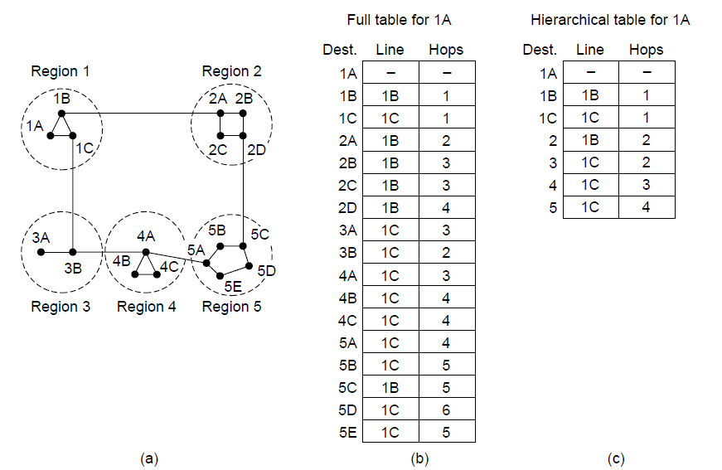
Hierarchical Routing
Hierarchical routing reduces the work of route computation but may result in slightly longer paths than flat routing
Best choice to reach nodes in 5 except for 5C
CN5E by Tanenbaum & Wetherall, © Pearson Education-Prentice Hall and D. Wetherall, 2011
Notes:
Hierarchical routing is what you think it is, e.g., to reach a given telephone first head towards the right country, then the right city in the country, then the phone in the city.
Each node keeps only one entry per region for other regions, plus an entry for all nodes in the local region.
The advantages are smaller routing tables, smaller routing computations to run at nodes, and fewer/smaller messages to send to describe the network.

Slide 20
Broadcast Routing
Broadcast sends a packet to all nodes
  One broadcasting method that requires no special features from the subnet is for the source to simply send a distinct packet to each destination. Not only is the method wasteful of bandwidth, but it also requires the source to have a complete list of all destinations. In practice this may be the only possibility, but it is the least desirable of the methods
  Flooding is another obvious candidate.
    it generates too many packets and consumes too much bandwidth
  Multi-destination routing >>>
  Using sink tree(broadcast—or any other convenient spanning tree)
Notes
CN5E by Tanenbaum & Wetherall, © Pearson Education-Prentice Hall and D. Wetherall, 2011
Notes:
Although flooding is ill-suited for ordinary point-to-point communication, for broadcasting it might rate serious consideration, especially if none of the methods described below are applicable. The problem with flooding as a broadcast technique is the same problem it has as a point-to-point routing algorithm: it generates too many packets and consumes too much bandwidth.
A spanning tree is a subset of the subnet that includes all the routers but contains no loops. If each router knows which of its lines belong to the spanning tree, it can copy an incoming broadcast packet onto all the spanning tree lines except the one it arrived on. This method makes excellent use of bandwidth, generating the absolute minimum number of packets necessary to do the job.
The only problem is that each router must have knowledge of some spanning tree for the method
to be applicable. Sometimes this information is available (e.g., with link state routing) but
sometimes it is not (e.g., with distance vector routing).

Slide 21
Broadcast Routing(multi-destination )
Each packet contains a list of destinations or a map indicating the desired destinations.
When a packet arrives at a router, the router checks all the destinations to determine the set of output lines that will be needed. (An output line is needed if it is the best route to at least one of the destinations.)
The router generates a new copy of the packet for each output line to be used and includes in each packet only those destinations that are to use the line. In effect, the destination set is partitioned among the output lines.
After a sufficient number of hops, each packet will carry only one destination and can be treated as a normal packet.
CN5E by Tanenbaum & Wetherall, © Pearson Education-Prentice Hall and D. Wetherall, 2011

Slide 22
Multicast Routing
Multicast sends to a subset of the nodes called a group
  Uses a different tree for each group and source
  Requires group management: Some way is needed to create and destroy groups, and to allow processes to join and leave groups.
CN5E by Tanenbaum & Wetherall, © Pearson Education-Prentice Hall and D. Wetherall, 2011
Notes:
Some applications require that widely-separated processes work together in groups, for example, a group of processes implementing a distributed database system.
In these situations, it is frequently necessary for one process to send a message to all the other members of the group.
If the group is small, it can just send each other member a point-to-point message.
If the group is large, this strategy is expensive.
Sometimes broadcasting can be used, but using broadcasting to inform 1000 machines on a million-node network is
inefficient because most receivers are not interested in the message (or worse yet, they are
definitely interested but are not supposed to see it).
Thus, we need a way to send messages to well-defined groups that are numerically large in size but small compared to the network as a
whole.

Slide 23
MANETs (Mobile Ad hoc NETworks)
The routers themselves are mobile, among the possibilities are:
  Military vehicles on a battlefield with no existing infrastructure.
  A fleet of ships at sea.
  Emergency workers at an earthquake that destroyed the infrastructure.
  A gathering of people with notebook computers in an area lacking 802.11.
In all these cases, and others, each node consists of a router and a host, usually on the same computer. Networks of nodes that just happen to be near each other are called ad hoc
networks or MANETs (Mobile Ad hoc NETworks).
CN5E by Tanenbaum & Wetherall, © Pearson Education-Prentice Hall and D. Wetherall, 2011

Slide 24
AODV (Ad hoc On-demand Distance Vector)
The network topology changes as wireless nodes move.
Routes are often made on demand AODV (Ad hoc On-demand Distance Vector) routing algorithm.
    It is a distant relative of the Bellman-Ford distance vector algorithm but adapted to work in a mobile environment and takes into account the limited bandwidth and low battery life found in this environment.
    Another unusual characteristic is that it is an on-demand algorithm, that is, it determines a route to some destination only when somebody wants to send a packet to that destination.
CN5E by Tanenbaum & Wetherall, © Pearson Education-Prentice Hall and D. Wetherall, 2011

Slide 25
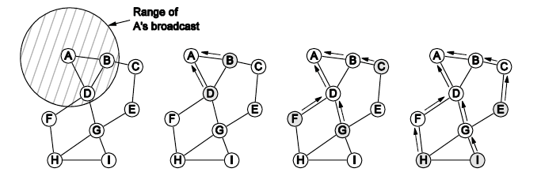
Routing in Ad Hoc Networks
A’s starts to find route to I
A’s broadcast reaches B & D
B’s and D’s broadcast reach C, F & G
C’s, F’s and G’s broadcast reach H & I
CN5E by Tanenbaum & Wetherall, © Pearson Education-Prentice Hall and D. Wetherall, 2011

Slide 26
Congestion Control (1)
Handling congestion is the responsibility of the Network and Transport layers working together
    We look at the Network portion here
  Traffic-aware routing »
  Admission control »
CN5E by Tanenbaum & Wetherall, © Pearson Education-Prentice Hall and D. Wetherall, 2011

Slide 27
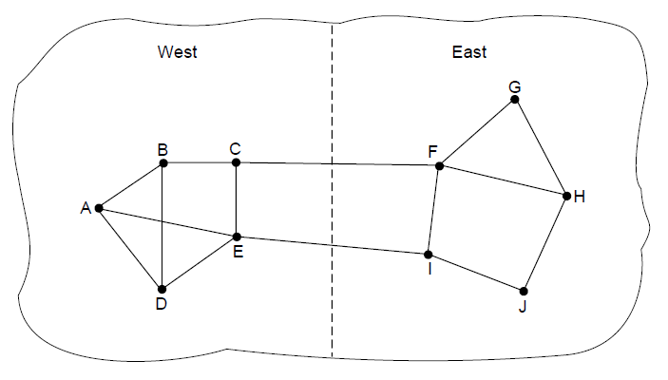
Traffic-Aware Routing
Choose routes depending on traffic, not just topology
  E.g., use EI for West-to-East traffic if CF is loaded
CN5E by Tanenbaum & Wetherall, © Pearson Education-Prentice Hall and D. Wetherall, 2011
Notes:
Our previous routes only considered topology; this approach can get more traffic through the network.
If not careful, then routing can notice CF is busy and switch traffic over to use EI, only to later notice that EI is busy and switch traffic back to CF. There are various techniques to avoid this: 1) change routes only slowly, e.g., traffic engineering in which an external system sets weights and the routing system does not otherwise adapt; and 2) using multiple paths at once, e.g., both CF and EI.

Slide 28
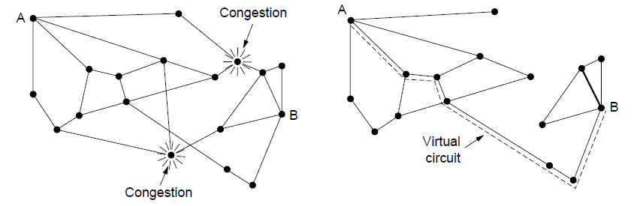
Admission Control
Admission control allows a new traffic load only if the network has sufficient capacity, e.g., with virtual circuits
  Can combine with looking for an uncongested route
Network with some congested nodes
Uncongested portion and route AB around congestion
CN5E by Tanenbaum & Wetherall, © Pearson Education-Prentice Hall and D. Wetherall, 2011

Slide 29
Internetworking
Internetworking joins multiple, different networks into a single larger network
CN5E by Tanenbaum & Wetherall, © Pearson Education-Prentice Hall and D. Wetherall, 2011

Slide 30
How Networks Differ
Differences can be large; complicates internetworking
  Different maximum packet size
  Different addressing schemes
  Different network access mechanism
  Different maximum packet lifetime
  Different transmission modes (connection-oriented, connectionless)
  Error control
  Flow control
CN5E by Tanenbaum & Wetherall, © Pearson Education-Prentice Hall and D. Wetherall, 2011

Slide 31
Fragmentation and Reassembly: Why?
Main reason: Different maximal packet sizes
  Lower-level protocols may need to break data up into smaller blocks, an action called fragmentation
  Each network only accepts blocks of a certain size, or it has a minimum and maximum limit for the allowed size of data blocks (e.g.
    Ethernet frames: minimum size = 72 bytes; maximum size = 1526 bytes
Fall 2010
2-<number>
CEG 4188

Slide 32
Fragmentation and Reassembly: Why?
Other reasons
  more efficient error control & smaller retransmission units
  fairer access to shared facilities
  Less waiting times of packets of higher priority in queues
  smaller buffers
Disadvantages
  more bandwidth wasted in overhead related data
  more interrupts & processing time
CEG 4188

Slide 33
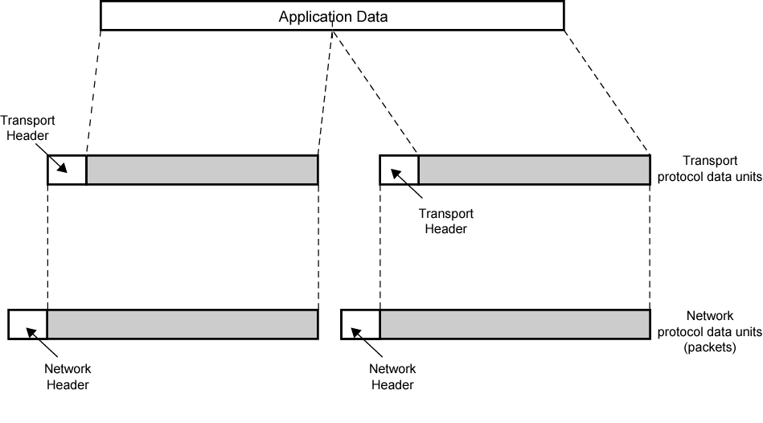
PDUs and Fragmentation
Fall 2010
2-<number>
CEG 4188
Notes:
Stallings DCC8e Figure 2.4 illustrates the general fragmentation process.

Slide 34
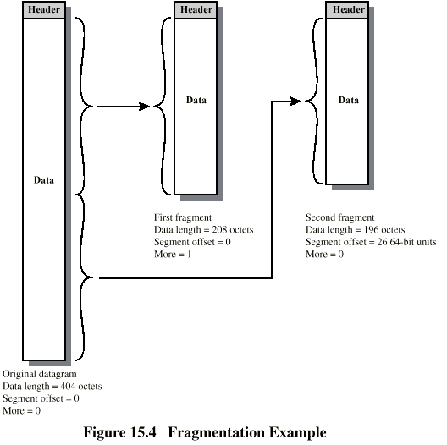
Fragmentation Example
Fall 2010
2-<number>
CEG 4188

Slide 35
Different Addressing Schemes
Introduce IP address as a global address
All hosts on the Internet must have a unique IP address.
Its way to identify machines on a network with a unique identifier, used to connect to another computer and allows transfers of files and e-mail.
Fall 2010
2-<number>
CEG 4188

Slide 36
IP Address
Used by higher layer protocols and Applications
Virtual(only understood by software)
Used for all communication across an internetwork
32-bit integer(Unique value for each host/interface)

Slide 37
IP Address Assignment
An IP address does not identify a specific computer
  Instead, each IP address identifies a connection between a computer and a network.
  A computer with multiple network connections (e.g., a router) must be assigned one IP address for each connection.

Slide 38
IP Address
Each IP address is divided into a prefix and a suffix
    prefix identifies the network to which the computer is attached
    suffix identifies the computer within that network
    we allocate some bits for prefix, some for suffix (total of 32 bits)
        large prefix, small suffix - many networks, few hosts per network
        small prefix, large suffix - few networks, many hosts per network
Network numbers are unique
    assignment of network numbers must be coordinated globally (Global authority )
    assignment of host addresses can be managed locally
Fall 2010
2-<number>
CEG 4188

Slide 39
IP Address Details
An IP address consists of four sections separated by dots.
  Commonly written in decimal
    →Dotted Decimal Notation
Each section is 8 bits long
  contains a number ranging from 0 to 255.

Slide 40
Dotted Decimal Notation
Shorthand for IP addresses
Allows humans to avoid binary
Represents each octet in decimal separated by dots
NOT the same as names like www.mutah.edu.jo

Slide 41
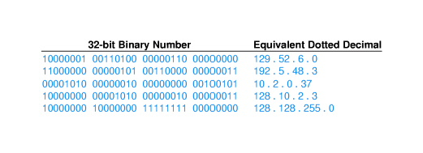
Examples of Dotted Decimal Notation

Slide 42

IP Address Details
IP address: 32-bit identifier for host, router interface
interface: connection between host, router and physical link
  routers typically have multiple interfaces
  host may have multiple interfaces
  IP addresses associated with interface, not host, router
223.1.1.1
223.1.2.1
223.1.1.2
223.1.1.4
223.1.2.9
223.1.2.2
223.1.1.3
223.1.3.27
223.1.3.1
223.1.3.2
223.1.1.1 = 11011111 00000001 00000001 00000001
223
1
1
1
Notes:
Audio lecture 13 starts here.

Slide 43
IP Address Details
IP address:
  network part (high order bits)
  host part (low order bits)
What’s a network? (from IP address perspective)
  device interfaces with same network part of IP address
  can physically reach each other without intervening router
  “Dotted quad” notation
223.1.1.1
223.1.2.1
223.1.1.2
223.1.1.4
223.1.2.9
223.1.2.2
223.1.1.3
223.1.3.27
LAN
223.1.3.1
223.1.3.2
network consisting of 3 IP networks
Notes:
What is a network??
Feel free to bring coffee if you want. You can get up and walk out during class if you feel you’re going to go to sleep.

Slide 44
Interconnected system consisting
of six networks
An IP address consists of two parts, one identifying the network and one identifying the node, or host.
The Class of the address determines which part belongs to the network address and which part belongs to the node address.
All nodes on a given network share the same network prefix but must have a unique host number.
223.1.1.1
223.1.1.2
223.1.1.4
223.1.1.3
223.1.9.2
223.1.7.0
223.1.9.1
223.1.7.1
223.1.8.1
223.1.8.0
223.1.2.6
223.1.3.27
223.1.2.1
223.1.2.2
223.1.3.1
223.1.3.2

Slide 45
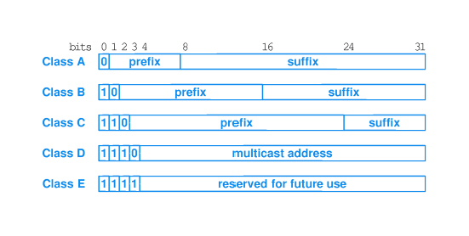
Class of IP Addresses (Historical)
Initial bits determined the class
The class determines the boundary between prefix and suffix

Slide 46
Class A Network
Binary address start with 0 →the decimal number can be anywhere from 1 to 126.
The first 8 bits (the first octet) identify the network and the remaining 24 bits indicate the host within the network.
An example of a Class A IP address is 102.168.212.226, where "102" identifies the network and "168.212.226" identifies the host on that network.

Slide 47
Class B Network
Binary addresses start with 10 →the decimal number can be anywhere from 128 to 191.
The first 16 bits (the first two octets) identify the network and the remaining 16 bits indicate the host within the network.
An example of a Class B IP address is 168.212.226.204 where "168.212" identifies the network and "226.204" identifies the host on that network.

Slide 48
Class C Network
Binary addresses start with 110 →the decimal number can be anywhere from 192 to 223.
The first 24 bits (the first three octets) identify the network and the remaining 8 bits indicate the host within the network.
An example of a Class C IP address is 200.168.212.226 where "200.168.212" identifies the network and "226" identifies the host on that network.

Slide 49
Class D Network
Binary addresses start with 1110 →the decimal number can be anywhere from 224 to 239
Class D networks are used to support multicasting.

Slide 50
Class E Network
Binary addresses start with 1111
→the decimal number can be anywhere from 240 to 255.
Class E networks are used for experimentation. They have never been documented or utilized in a standard way

Slide 51





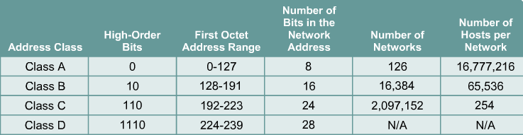
Every IP address has two parts:
Network
Host
IP addresses are divided into classes A,B and C to define large, medium, and small networks.
The Class D address class was created to enable multicasting.
IETF reserves Class E addresses for its own research.

Slide 52
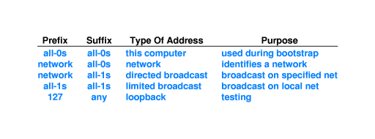
Special IP Addresses
In addition to assigning a unique address to each host, the IP addressing scheme defines a set of special addresses that are reserved and never assigned to hosts.

Slide 53
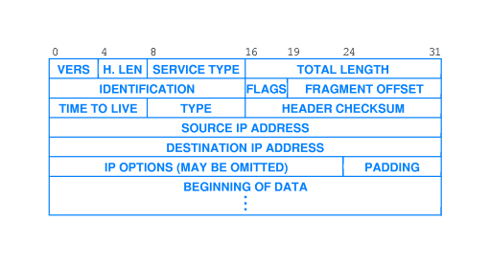
IP Packet Header Format

Slide 54
IP Packet Header Format
VERS is the IP protocol version (currently 4).
H-LEN is the header length in 32-bit words..
FRAGMENT OFFSET measured in eight-byte units.
SERVICE TYPE (left to right) :
  3-bit PRECEDENCE is generally ignored today.
TOTAL LENGTH is header and data in octets (bytes).
IDENTIFICATION is a number uniquely identifying each datagram sent by a host.
Notes:
H-LEN is the header length in 32-bit words. This is required because options may be present in the header.
TOTAL LENGTH This is required because some data-link layer protocols (e.g. Ethernet) pad small frames to a minimum length.

Slide 55
FLAGS (left to right)
  Unused, 1-bit.
  DON'T FRAGMENT flag
  MORE FRAGMENTS flag
FRAGMENT OFFSET measured in eight-byte.
TIME TO LIVE (TTL) specifies how many routers may process this datagram before it is discarded.
TYPE identifies which upper-level protocol provided the data for IP to send (e.g. ICMP, TCP or UDP).
HEADER CHECKSUM, as the name implies, is calculated over the header only.
SOURCE IP ADDRESS identifies the original sender of the datagram.
DESTINATION IP ADDRESS identifies the final recipient of the datagram.
Notes:
TIME TO LIVE (TTL) :It is initialised by the sender and decremented by one by each router that handles the datagram. When the field reaches zero, the datagram is discarded and the sender notified with an ICMP message.

Slide 56
IPv4
IPv4 is version 4 of IP. It was the first version of the Internet Protocol to be widely deployed, and forms the basis for the current (as of 2004) Internet.
IPv4 uses 32-bit addresses, limiting it to 4,294,967,296 unique addresses, many of which are reserved for special purposes such as local networks or multicast addresses, reducing the number of addresses that can be allocated as public Internet addresses.

Slide 57
IPv4
As the number of addresses available is consumed, an IPv4 address shortage appears to be inevitable in the long run.
This limitation has helped stimulate the push towards IPv6, which is currently in the early stages of deployment, and is expected to eventually replace IPv4.

Slide 58
IPv6
IPv6 is version 6 of the Internet Protocol. IPv6 is intended to replace the previous standard, IPv4, which only supports up to about 4 billion (4 × 109) addresses, whereas IPv6 supports up to about 3.4 × 1038 addresses.

Slide 59
IPv6
IPv6 is the second version of the Internet Protocol to be widely deployed, and is expected to form the basis for future expansion of the Internet.
The compelling reason behind the formation of IPv6 was lack of address space, especially in the heavily populated countries of Asia such as India and China.

Slide 60
IPv6 Notation
IPv6 addresses are 128 bits long but are normally written as eight groups of 4 hexadecimal digits each.
For example,
3ffe:6a88:85a3:08d3:1319:8a2e:0370:7344

Slide 61
IPv6 Notation
If a 4 digit group is 0000, it may be omitted.
  For example:
  3ffe:6a88:85a3:0000:1319:8a2e:0370:7344
  is the same IPv6 address as 3ffe:6a88:85a3::1319:8a2e:0370:7344

Slide 62
Internet Control Protocols (1)
IP works with the help of several control protocols:
  ICMP (Internet Control Message Protocol) is a companion to IP that returns error info
    Required, and used in many ways, e.g., for traceroute
  ARP (Address Resolution Protocol) finds Ethernet address of a local IP address
    Glue that is needed to send any IP packets
    Host queries an address and the owner replies
  DHCP (Dynamic Host Configuration Protocol) assigns a local IP address to a host
    Gets host started by automatically configuring it
    Host sends request to server, which grants a lease
CN5E by Tanenbaum & Wetherall, © Pearson Education-Prentice Hall and D. Wetherall, 2011

Slide 63
End
Chapter 5
CN5E by Tanenbaum & Wetherall, © Pearson Education-Prentice Hall and D. Wetherall, 2011

